Slide 1

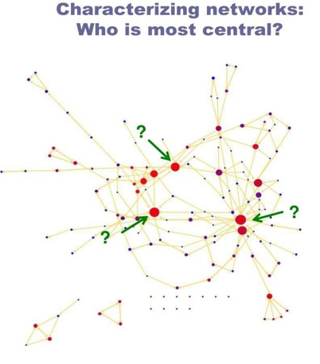
Network :structural chracteristics

Slide 2
Network :structural chracteristics
Clustering Coefficients
Closeness Centrality
Betweenness Centrality
Eigenvector Centrality
Notes:
The Human Disease Network, whose nodes are diseases connected if they have common genetic origin.
K.-I. Goh, M. E. Cusick, D. Valle, B. Childs, M. Vidal, and A.-L. Barabasi.
The human disease network. PNAS, 104:8685–8690, 2007.

Slide 3

Clustering Coefficients
The clustering coefficient captures the degree to which the neighbors of a given node link to each other. For a node with degree the local clustering coefficient is defined as

Slide 4
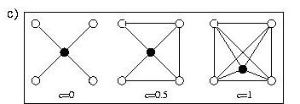
Clustering Coefficients
The clustering coefficient captures the degree to which the neighbors of a given node link to each other. For a node with degree the local clustering coefficient is defined as
CC of the center node (purple)
Notes:
The Human Disease Network, whose nodes are diseases connected if they have common genetic origin.
K.-I. Goh, M. E. Cusick, D. Valle, B. Childs, M. Vidal, and A.-L. Barabasi.
The human disease network. PNAS, 104:8685–8690, 2007.

Slide 5
Clustering Coefficients
Notes:
The Human Disease Network, whose nodes are diseases connected if they have common genetic origin.
K.-I. Goh, M. E. Cusick, D. Valle, B. Childs, M. Vidal, and A.-L. Barabasi.
The human disease network. PNAS, 104:8685–8690, 2007.

Slide 6
Clustering Coefficients
https://github.com/mdhumphries/SmallWorldNess
Notes:
The Human Disease Network, whose nodes are diseases connected if they have common genetic origin.
K.-I. Goh, M. E. Cusick, D. Valle, B. Childs, M. Vidal, and A.-L. Barabasi.
The human disease network. PNAS, 104:8685–8690, 2007.

Slide 7
Clustering Coefficients
Notes:
The Human Disease Network, whose nodes are diseases connected if they have common genetic origin.
K.-I. Goh, M. E. Cusick, D. Valle, B. Childs, M. Vidal, and A.-L. Barabasi.
The human disease network. PNAS, 104:8685–8690, 2007.

Slide 8
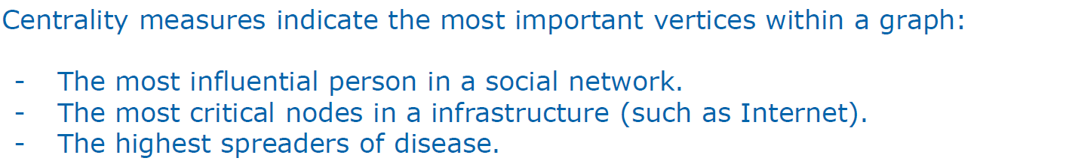
Network Analysis: Centrality measures

Slide 9
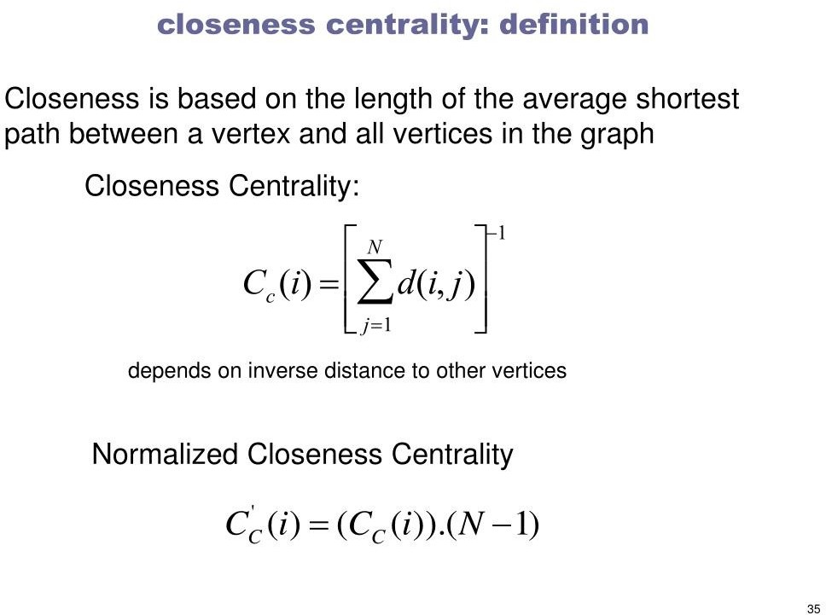
Closeness Centrality
$C_{u}=1/{\sum_{v=1}^{n}{d\left(u,v\right)}}$
$C_{i}=1/{\sum_{j=1}^{n}{d\left(i,j\right)}}$
Closeness centrality can be viewed as the efficiency of a vertex in spreading information to all other vertices.
Ralucca Gera, NPS

Slide 10

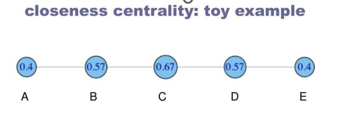
Closeness Centrality
$C_{i}=1/{\sum_{j=1}^{n}{d\left(i,j\right)}}$
Ralucca Gera, NPS

Slide 11
Eigenvector Centrality
A natural extension of degree centrality is eigenvector centrality.
In-degree centrality awards one centrality point for every link a node receives. But not all vertices are equivalent: some are more relevant than others, and, reasonably, endorsements from important nodes count more.
$C_{i}=1/{\sum_{j=1}^{n}{d\left(i,j\right)}}$
Ralucca Gera, NPS

Slide 12
Eigenvector Centrality
A natural extension of degree centrality is eigenvector centrality.
In-degree centrality awards one centrality point for every link a node receives. But not all vertices are equivalent: some are more relevant than others, and, reasonably, endorsements from important nodes count more.
EVC : A node is important if it is linked to by other important nodes.
$C_{i}=1/{\sum_{j=1}^{n}{d\left(i,j\right)}}$
Ralucca Gera, NPS

Slide 13
Eigenvector Centrality
$C_{i}=1/{\sum_{j=1}^{n}{d\left(i,j\right)}}$
Ralucca Gera, NPS

Slide 14
Eigenvector Centrality
$C_{i}=1/{\sum_{j=1}^{n}{d\left(i,j\right)}}$
Ralucca Gera, NPS

Slide 15
Eigenvector Centrality
$C_{i}=1/{\sum_{j=1}^{n}{d\left(i,j\right)}}$
Ralucca Gera, NPS

Slide 16
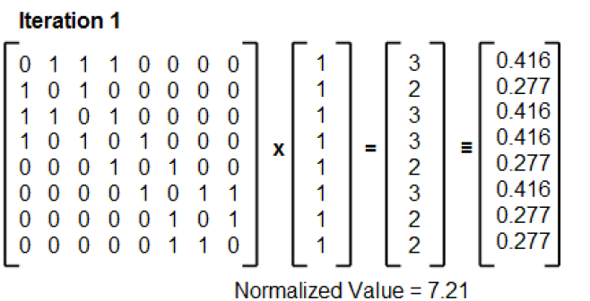
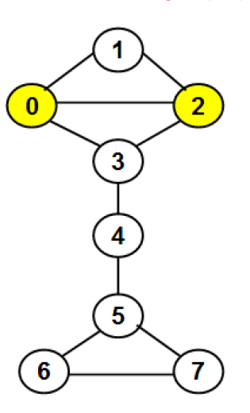
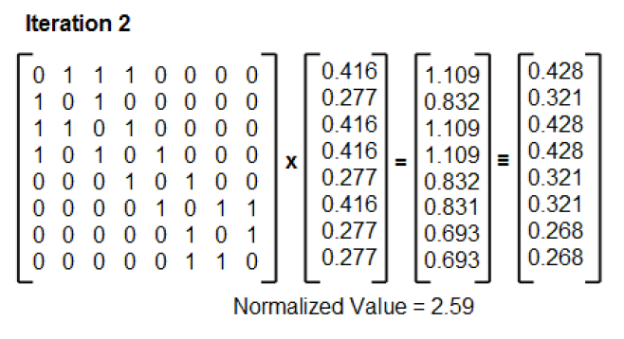
Eigenvector Centrality
$C_{i}=1/{\sum_{j=1}^{n}{d\left(i,j\right)}}$
Dr. Natarajan Meghanathan
Ralucca Gera, NPS

Slide 17
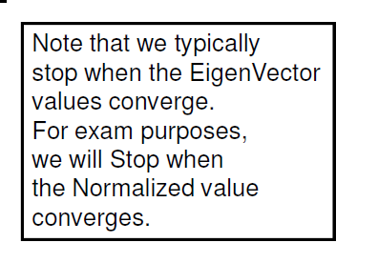
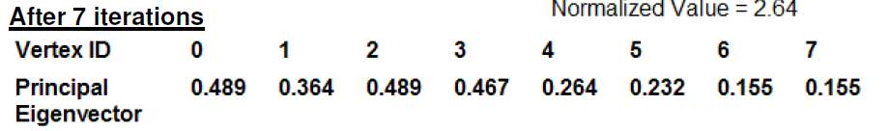
Eigenvector Centrality
$C_{i}=1/{\sum_{j=1}^{n}{d\left(i,j\right)}}$
Ralucca Gera, NPS

Slide 18
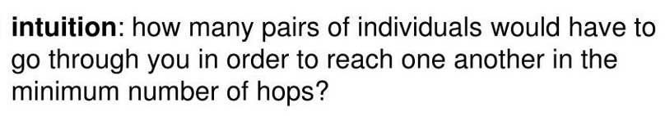
Node Betweenness
Ralucca Gera, NPS

Slide 19
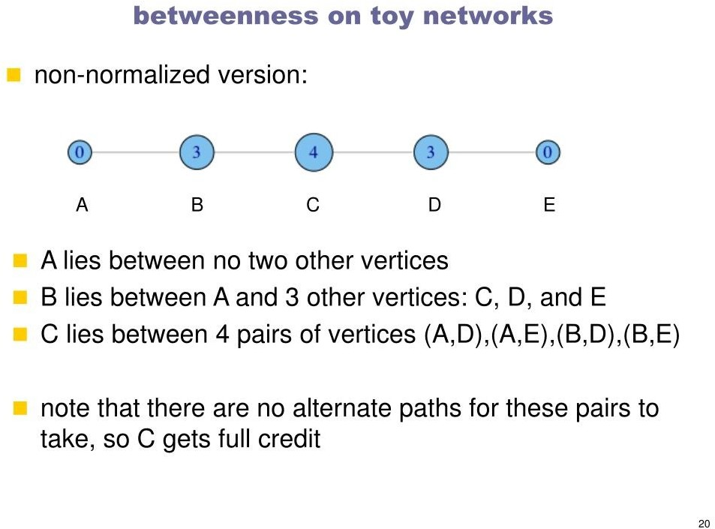
Node Betweenness
$C_{i}=1/{\sum_{j=1}^{n}{d\left(i,j\right)}}$
Ralucca Gera, NPS

Slide 20
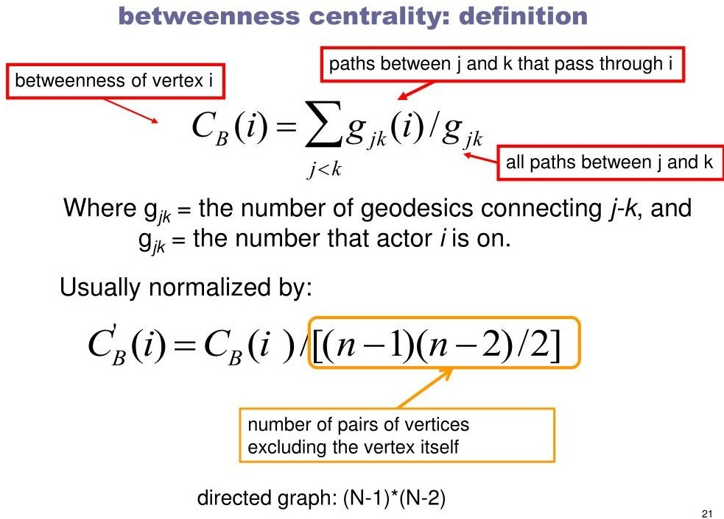
Node Betweenness
Ralucca Gera, NPS

Slide 21
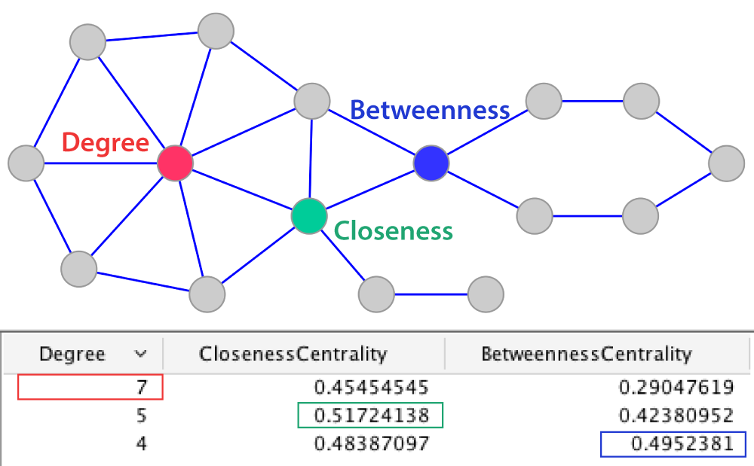
Centralities
$C_{i}=1/{\sum_{j=1}^{n}{d\left(i,j\right)}}$
Ralucca Gera, NPS

Slide 22
Route Problem
DUNLOP
AIRPORT
ISI
HOME
NAGERBAZAR
SINTHI
DUMDUM
CHIRIAMORE
Ralucca Gera, NPS

